Slide 1
Digital Computers
The word “Digital” implies that information in computer is represented by variable that takes a limited number of discrete values.
Computers of 1940 consists of 10 discrete levels.
Today’s computer is based on Binary number system which is having two discrete levels 0 & 1.
Each binary digit is called a bit.
Bits are combined to make meaningful information like data, information etc.

Slide 2
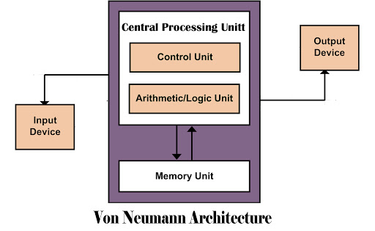
Digital Computers
Von Neumann architecture is based on the stored-program computer concept, where instruction and data are stored in the same memory.

Slide 3
Digital Computers
Computer System is having two basic parts:
Hardware: Electronic & Electromechanical devices
Software: Instruction & Data

Slide 4
Some Important Terms
It is important at this point to distinguish between computer architecture, computer organization and computer design.
Computer Architecture(CA): The Computer architecture is concerned with the Instruction set, Instruction formats, specific registers etc, which is basically the structure and behavior of a computer as seen by the user.
Computer Organization(CO): It is concerned with the way the hardware components operate and the way they are connected together to form the computer system.

Slide 5
Some Important Terms
  Computer Design: Once the hardware and other specifications are formulated, it is task of designer to develop the hardware of the system. It is concerned with what hardware to be used and how they have to be connected.

Slide 6
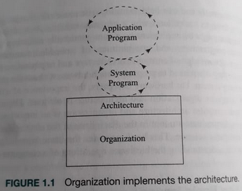
Some Important Terms

Slide 7
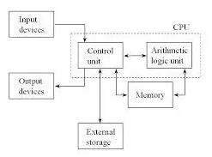
Basic Organization of the Computer
The important parts of a digital computer are the CPU, main memory, secondary storage and peripheral devices.
A bus interconnecting all the components of a computer is usually called a system bus.

Slide 8
Basic Organization of the Computer
CPU: It contains ALU for manipulating data, number of registers for storing data and Control unit for generating necessary control signals.
Main memory: It is also called Random Access Memory (RAM) which is used to store and read the data required for executing instructions. Currently, we are using dynamic RAM (DRAM) modules.
Input Devices: It is used to provide input to the computer like the keyboard.

Slide 9
Basic Organization of the Computer
Output Devices: It is used to take output from the computer like the monitor.
External or Secondary Storage: It is used to store data in secondary storage device like hard-disk.
System Bus: The system bus is an internal bus, intended to connect the processor with internal hardware devices. The three internal buses associated with system bus are: data bus, address bus, and control bus.

Slide 10
Number System
Base or Radix: A number system of base or radix, r is system that uses distinct symbols for r digits.
Decimal: A decimal number is having base as 10. The 10 symbols are 0, 1, 2, 3, 4, 5, 6, 7, 8, 9.
Binary: A binary number is having base as 2. The 2 symbols are 0 & 1.
Octal: A octal number is having base as 8. The 8 symbols are 0, 1, 2, 3, 4, 5, 6 & 7.
Hexadecimal: A hexadecimal number is having base as 16. The symbols used are 0, 1, 2, 3, 4, 5, 6, 8, 9 , A, B, C, D, E, F.

Slide 11


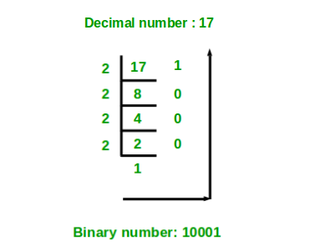
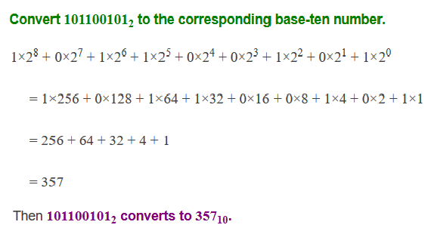
Decimal(10) to Binary(2) & Vice-versa

Slide 12


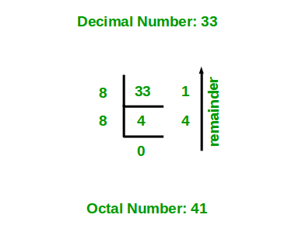
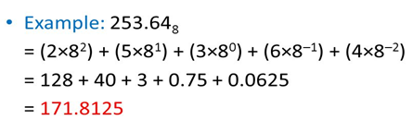
Decimal(10) to Octal(8) & Vice-versa

Slide 13


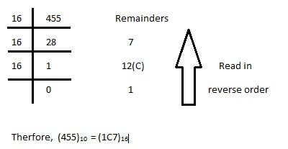
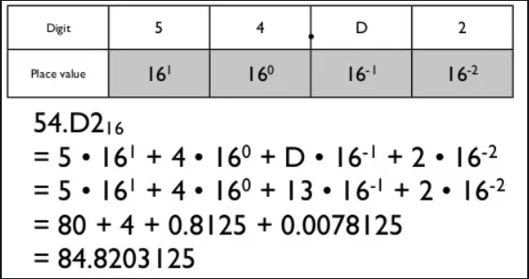
Decimal(10) to Hexadecimal(16) & Vice-versa

Slide 14
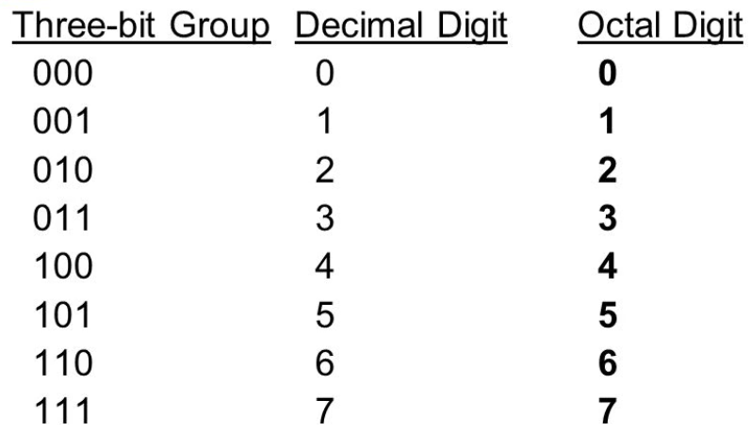
Binary Coded Octal
Three binary digits (also known as binary-coded octal) can be combined to form one octal digit.

Slide 15
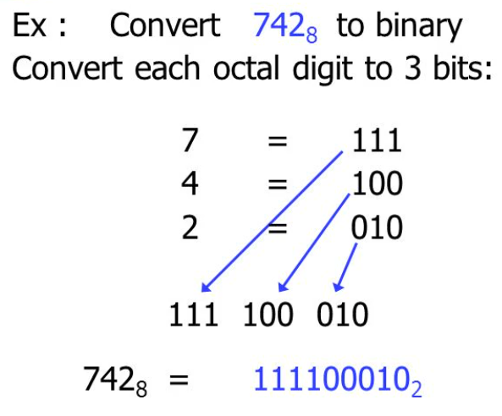
Base (8) to base (2)

Slide 16
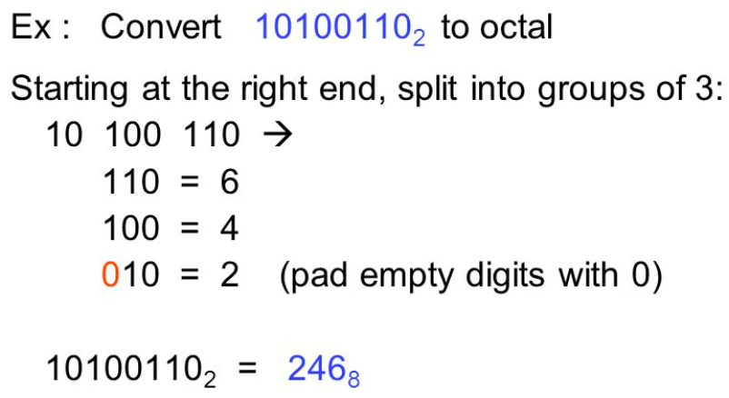
Base (2) to base (8)

Slide 17
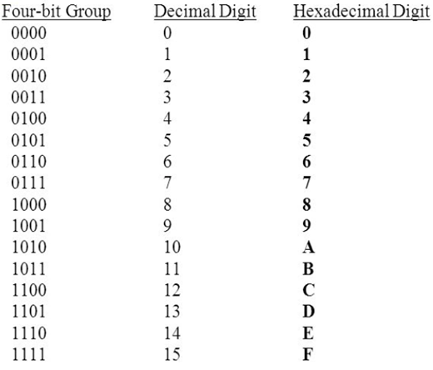
Binary Coded Hexadecimal
Four binary digits (also known as binary-coded hexadecimal) can be combined to form one hexadecimal digit.

Slide 18
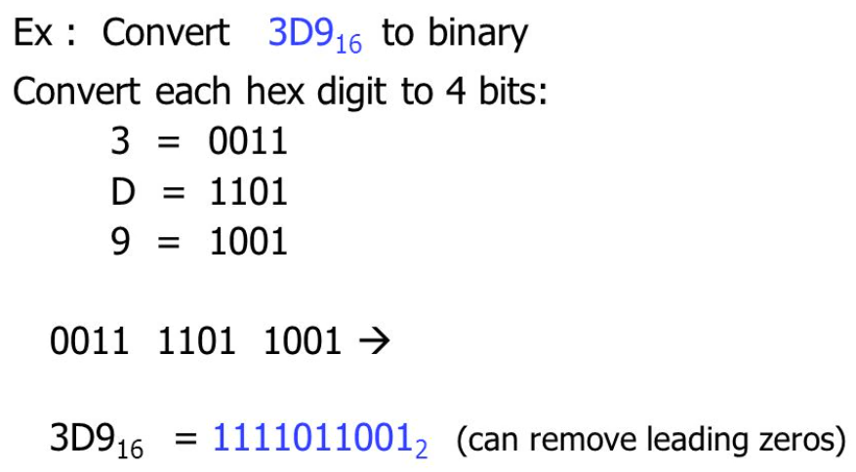
Base (16) to base (2)

Slide 19
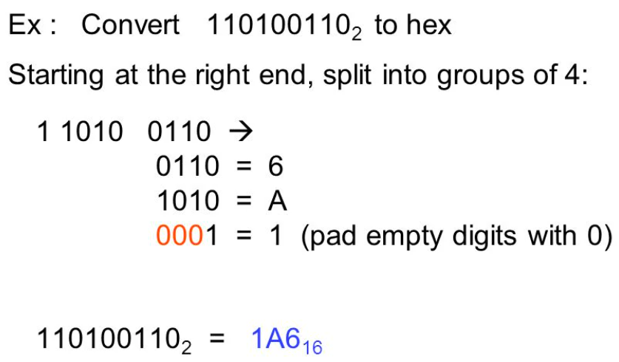
Base (2) to base (16)

Slide 20
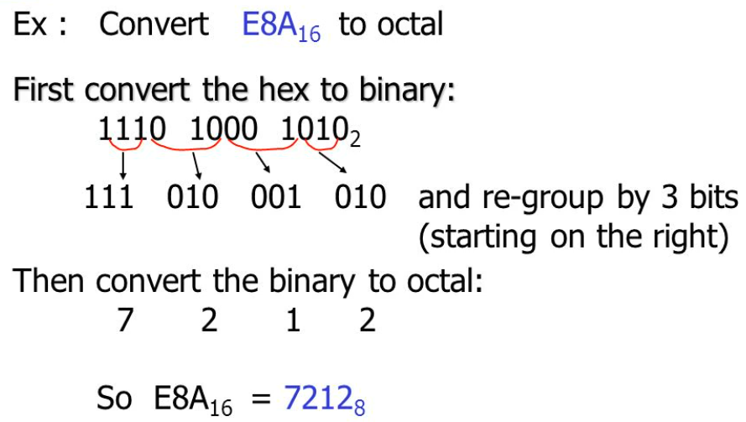
Hexadecimal(16) to Octal(8)

Slide 21
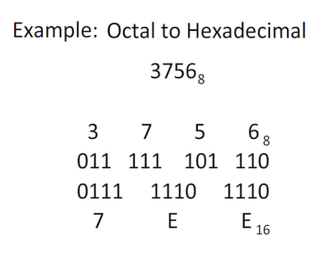
Octal(8) to Hexadecimal(16)

Slide 22
Complements
Complements are used in digital computers for simplifying the subtraction process and for logical manipulation.
There are two types of complements for each base r system. r’s complement and the (r-1)’s compliment.
When the value of r is 10, it is termed as 10’s and 9’s complement.
When the value of r is 2, it is termed as 2’s and 1’s complement.

Slide 23
9’s Complement
In general, the 9’s complement of the unsigned numbers 546700 & 12389 are
9 9 9 9 9 9 9 9 9 9 9
- 5 4 6 7 0 0 - 1 2 3 8 9
-------------- ------------
4 5 3 2 9 9 8 7 6 1 0

Slide 24
10’s Complement
In general, the 10’s complement of the unsigned numbers 546700 & 12389 are
9 9 9 9 9 9 9 9 9 9 9
- 5 4 6 7 0 0 - 1 2 3 8 9
-------------- ------------
4 5 3 2 9 9 8 7 6 1 0
+ 1 + 1
-------------- ------------
4 5 3 3 0 0 8 7 6 1 1

Slide 25
Subtraction of Unsigned number - 9’s Complement
Example 1 : Using 9's complement, subtract 7 2 5 3 2 – 3 2 5 0 (M > N)
9’s Complement of 3 2 5 0 is 9 9 9 9 9 - 0 3 2 5 0 = 9 6 7 4 9
7 2 5 3 2
        + 9 6 7 4 9
------------
1 6 9 2 8 1
+ 1
------------
6 9 2 8 2
End carry indicates that result is Positive. Carry need to be added to the obtained value to get final result.
There is end carry
Final Result

Slide 26
Subtraction of Unsigned number - 9’s Complement
Example 2 : Using 9's complement, subtract 3 2 5 0 – 7 2 5 3 2 (M < N)
9’s Complement of 7 2 5 3 2 is 9 9 9 9 9 – 7 2 5 3 2 = 2 7 4 6 7
0 3 2 5 0
        + 2 7 4 6 7
------------
3 0 7 1 7
9 9 9 9 9
        - 3 0 7 1 7
------------
6 9 2 8 2
No end carry indicates that result is Negative. Do 9’s complement of the obtained value to get final result.
There is no end carry.
9's complement of 30717
Final Result

Slide 27
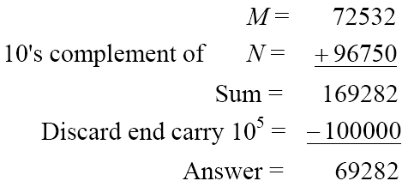
Subtraction of Unsigned number - 10’s Complement
Example 1 : Using 10's complement, subtract 7 2 5 3 2 – 3 2 5 0 (M > N)
10’s Complement of 3 2 5 0 is 9 9 9 9 9 - 0 3 2 5 0 = 9 6 7 4 9 + 1 = 9 6 7 5 0
End carry indicates that final result is Positive. Ignore end carry.
There is end carry
Final Result

Slide 28
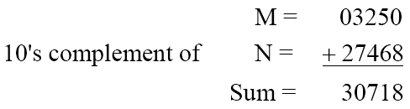
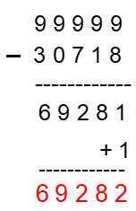
Subtraction of Unsigned number - 10’s Complement
Example 2 : Using 10's complement, subtract 3 2 5 0 – 7 2 5 3 2 (M < N)
10’s Complement of 7 2 5 3 2 is 9 9 9 9 9 – 7 2 5 3 2 = 2 7 4 6 7 + 1 = 2 7 4 6 8
No end carry indicates the end result is Negative. Do 10’s complement of the obtained value to get final result.
There is no end carry.
10's complement of 30718
Final Result

Slide 29
1’s Complement
In general, the 1’s Complement of the unsigned numbers 110011 & 11000 are
1 1 1 1 1 1 1 1 1 1 1
- 1 1 0 0 1 1 - 1 1 0 0 0
-------------- ------------
0 0 1 1 0 0 0 0 1 1 1
or
Generally , we know how to do complement
For 110011, 1’s complement is 001100
For 11000, 1’s complement is 00111

Slide 30
2’s Complement
In general, the 2’s Complement of the unsigned numbers 110011 & 11000 are
1 1 1 1 1 1 1 1 1 1 1
- 1 1 0 0 1 1 - 1 1 0 0 0
--------------- ------------
0 0 1 1 0 0 0 0 1 1 1
+ 1 + 1
-------------- ------------
0 0 1 1 0 1 0 1 0 0 0
or
Generally , we know how to do complement
For 110011, 2’s complement is 001100 + 1 = 001101
For 11000, 2’s complement is 00111 + 1 = 01000

Slide 31
Subtraction of Unsigned number - 1’s Complement
Example 1 :
Using 1's complement, subtract (84) 1010100 – (67) 1000011 (M > N)
1’s Complement of 1000011 is 0111100
1010100
        + 0111100
------------
1 0010000
+ 1
------------
0010001
End carry indicates that result is Positive. Carry need to be added to obtained value to get final result.
There is end carry
Final Result

Slide 32
Subtraction of Unsigned number - 1’s Complement
Example 2 :
Using 1's complement, subtract (67) 1000011 - (84) 1010100 (M < N)
1’s Complement of 1010100 is 0101011
1000011
+ 0101011
------------
1101110
0010001
No end carry indicates that result is Negative. Do 1’s complement of the obtained value to get final result.
There is no end carry.
1's complement of 1101110
Final Result

Slide 33
Subtraction of Unsigned number - 2’s Complement
Example 1 :
Using 2's complement, subtract (84) 1010100 – (67) 1000011 (M > N)
2’s Complement of 1000011 is 0111100 + 1 = 0111101
1010100
        + 0111101
------------
1 0010001
0010001
End carry indicates that final result is Positive. Ignore end carry.
End carry indicates that final result is Positive.
There is end carry
Final Result

Slide 34
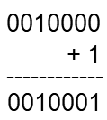
Subtraction of Unsigned number - 2’s Complement
Example 2
Using 2's complement, subtract (67) 1000011 - (84) 1010100 (M < N)
2’s Complement of 1010100 is 0101011 + 1 = 0101100
1000011
+ 0101100
------------
1101111
No end carry indicates the end result is Negative. Do 10’s complement of the obtained value to get final result.
There is no end carry.
2's complement of 1101111
Final Result

